Slide 1

0
1
0
?
0
1
0
1
1
?
1
0
1
1
1
0
0
1
?
1
0
1
2
1
?
0
2
2
2
0
2
2
GENOTYPE IMPUTATION
LOW RANK MATRIX FACTORIZATION
Ronak Sumbaly
Notes:
Hello everyone listening. My name is Ronak and the project that I worked on for the course is Genotype Imputation using Low Rank Matrix Factorization. The image basically embodies the entire concept of the project so let’s begin on what it is and now it is of great importance.

Slide 2
Genotype Imputation
Whole genome resequencing of thousands of individuals is not yet feasible
Genotype imputation is the term used to describe the process of predicting or imputing genotypes that are not directly assayed in a sample of individuals.
This can be as simple (and naive) as choosing a random value from the domain of the genetic data, or as complicated as analyzing all existing values to determine the most likely value for missing data points.
Notes:
A large problem in bioinformatics is the inability to get complete data. Since it is a data driven field, this creates many issues. In sequencing data aspect of bioinformatics, we often find difficulties in generating genotypes of individuals for a variety of reasons. Sequencing machines have error. Certain parts of the genome such as areas near centromeres are hard to sequence. In situations like these it is not feasible to resequence the entire genome. We can fill these gaps through something called as genotype imputation, the idea being infer missing data from already observed data. While this is a very pertinent concept in bioinformatics, it is truly a question of any data driven field. Solution range from a naïve one of choosing a random value from our domain of genetic data to a complicated approach of analyzing patterns and relationships between SNPs.

Slide 3
Biological Context
Re-Genotyping
Meta-Analysis
Improves Power
Re-genotyping is usually not possible due to financial constraints.
Meta-analysis of datasets that have been genotyped on different arrays, by increasing the overlap of variants available for analysis between arrays.
Keep costs down and restore some of the power lost by errors in data
Notes:
Why is imputation important in a biological context?
As indicated previously, sequencing can lead to errors and re-genotyping is not a feasible option and hence imputation provides us with a solution.
Genotyping arrays used for GWAS are based on tagging SNPs and therefore do not directly genotype all variation in the genome. Imputation of the genotypes to a reference panel that has been genotyped for a greater number of variants, boosts the coverage of genomic variation beyond the original genotypes. As a consequence, we can assess the effect of more SNPs than those on the original micro-array. Importantly, imputation has facilitated meta-analysis of datasets that have been genotyped on different arrays, by increasing the overlap of variants available for analysis between arrays.

Slide 4
The problem we want to solve
INDIVIDUALS
INDIVIDUALS
A
B
C
D
A
B
C
D
0
?
0
1
0
1
0
1
1
1
1
?
1
1
1
0
SNPS
SNPS
?
1
?
1
0
1
2
1
2
0
2
2
2
0
2
2
Notes:
Let us have a look at the problem in hand.. Coming back to our main front image we can see that
Given n individuals and m SNPs with missing values in our genotype data our task is to impute these values with the most likely value.
As seen in the image. The red question marks indicate missing SNP values for individuals and after imputation what is expected are genotype values for these SNPs & individual that are most probable.

Slide 5
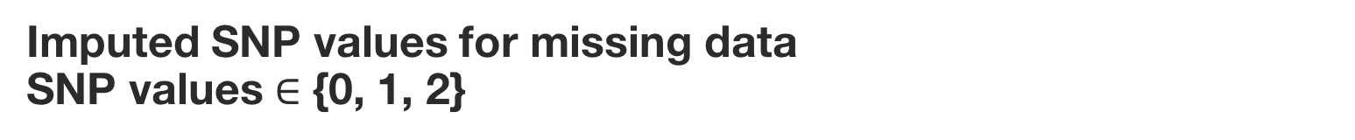
Computational Problem
GOAL
Perform Genotype Imputation
INPUT
Genotype Data (n individuals and m SNPs)
OUTPUT
Imputed SNP values for missing data
SNP values $∈$ {0, 1, 2}
EVALUATION
Accuracy of prediction
Notes:
Okay so lets have a look at the Computational problem in hand.
Our goal as stated before is to perform Genotype imputation.
The input that we will be having is Genotype Data with n individuals and m SNPs, which including missing SNP values as well
The output will simply be the imputed SNP data matrix wherein the missing values are either replaced with (0, 1 or 2)
In order to evaluate the approach I’ll be using accuracy of the prediction as my statistics, which simply means the checking the % of values that match with the correct outcome.
Lets have a closer look with what we will be working with.

Slide 6
Dataset & Simulation
DATASET
1000 Genome Project – Chromosome 22 data
1092
400K
Individuals
SNPs
SIMULATION
Take subset of dataset
Mask random values in the dataset and perform imputation
Increase the count of SNPs being considered and mask more random positions to obtain better analysis results
ASSUMPTION
Individuals are unrelated.
Notes:
So I made use of two datasets. The 1000 Genome Project – Chromosome 22 genotype data which comprised of 1092 individuals and around 400K snps and also the imputation project data that was provided by Micheal for evaluation.
Since the project data already had missing values in them, I created a simulation script to generate missing values in the 1000 genome dataset. Since the dataset was quite large in terms of SNPs I considered subsets of SNPs and kept a constant threshold of 40 %.
Meaning I masked 40 % of the dataset by selecting random positions and then performed imputation on the data. The SNP count was increased gradually for evaluation. A single assumption is being made which is that the individuals in the dataset are unrelated
which actually isn’t true but for the purpose of the project we just assume it. So let’s start with my baseline method.

Slide 7
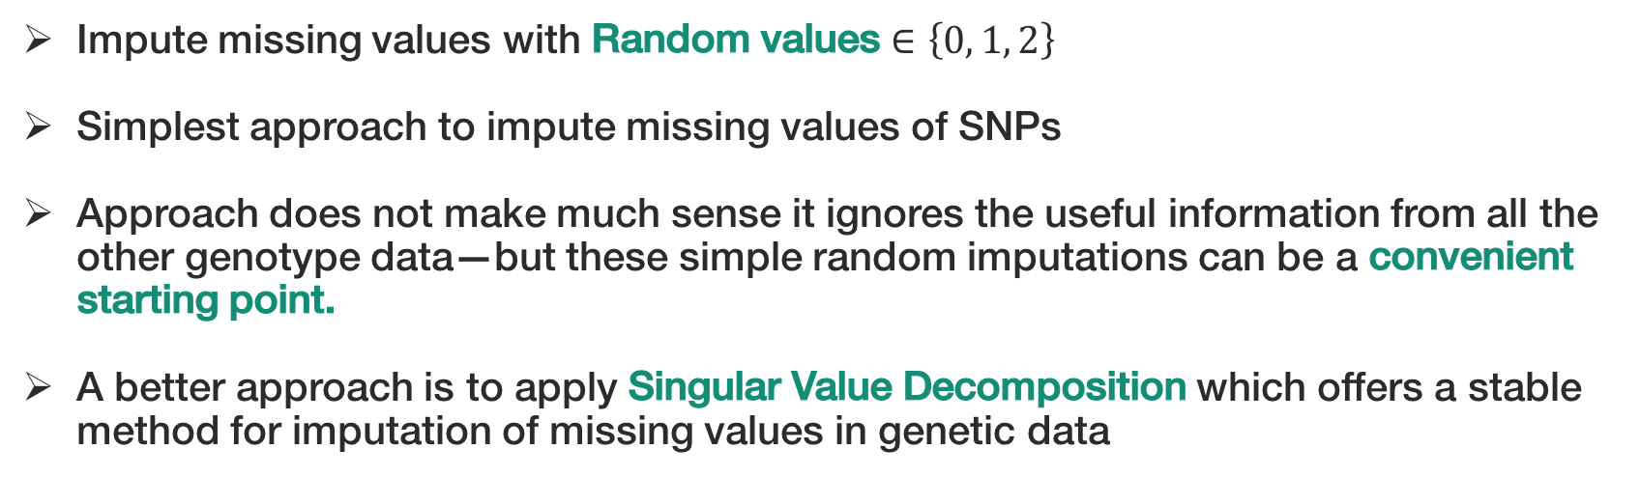
Baseline Method – Random Imputation
Impute missing values with Random values $∈\left\{0, 1, 2\right\}$
Simplest approach to impute missing values of SNPs
Approach does not make much sense it ignores the useful information from all the other genotype data—but these simple random imputations can be a convenient starting point.
A better approach is to apply Singular Value Decomposition which offers a stable method for imputation of missing values in genetic data
0
1
0
?
2
?
0
0
1
0
1
2
2
0
Random Sampling
Of Values
0
1
0
2
2
1
0
0
1
0
0
2
1
0
Notes:
As indicated before the most simplest and naïve approach to imputation is replacing all the missing values with random values of 0, 1 or 2.
Even though the approach does not make much sense and ignores the useful information from all the other genotype data, but for my convenience it acts as a good starting point.
A clear drawback can be visualized through this image below wherein random imputation might produce multiple results while only one of them might be correct we already have an issue of fluctuating accuracies.
So a better approach that is applied is that of a Singular Value Decomposition or SVD which basically offers a much stable method for imputation of missing values in genetic data.

Slide 8
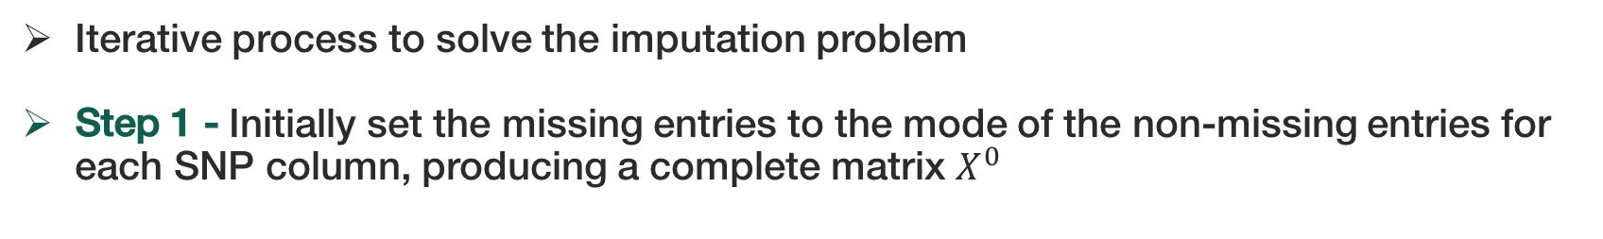
Improved Method – SVD Imputation
Iterative process to solve the imputation problem
Step 1 - Initially set the missing entries to the mode of the non-missing entries for each SNP column, producing a complete matrix $X^{0}$
0
1
0
?
0
1
0
0
Mode Imputation
1
?
1
0
1
1
1
0
SNPS
0
1
?
2
0
1
0
2
?
0
2
2
2
0
2
2
Notes:
SVD Imputation is a popular concept that was applied on the Netflix challenge of predicting user ratings of movies using already observed data of other users. A similar approach is applied but with a couple of modifications to the logic of the algorithm. SVD basically applies the concept of Low Rank matrix factorization which is applied iteratively to solve the imputation problem. So let me explain how it works.
The first step in our SVD imputation process is to replace all the missing values with the mode of the each SNP respectively. Visually it is seen that the algorithm calculates the mode of each SNP and replaces the missing value for that row with the mode of that SNP. If there are two values that have the same frequency then the lower value is chosen as the mode. This produces a complete matrix which we denote as X0. Moving on to the next step.

Slide 9
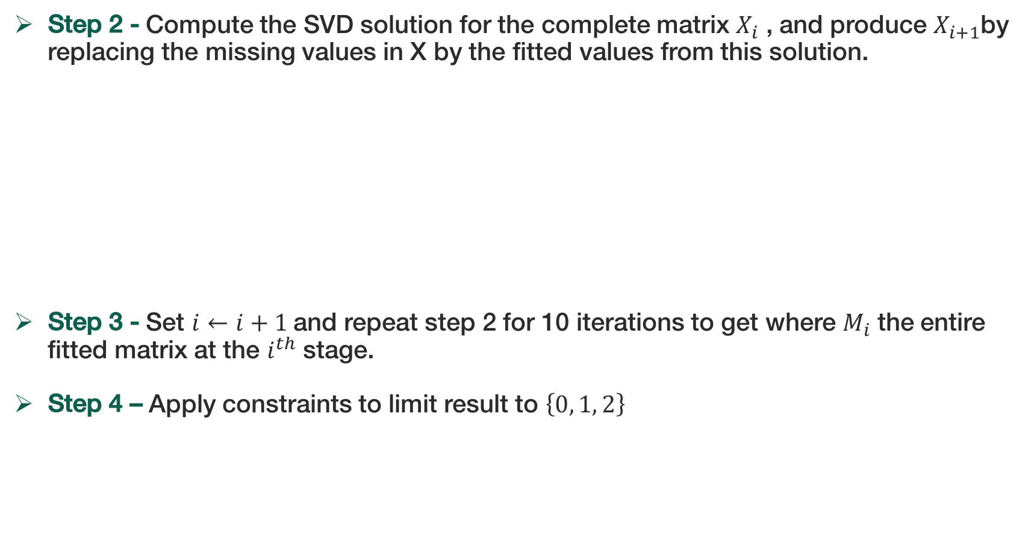
SVD Imputation
Step 2 - Compute the SVD solution for the complete matrix $X_{i}$ , and produce $X_{i+1}$by replacing the missing values in X by the fitted values from this solution.
Step 3 - Set $i←i+1$and repeat step 2 for 10 iterations to get where $M_{i}$ the entire fitted matrix at the $i^{th}$ stage.
Step 4 – Apply constraints to limit result to $\left\{0, 1, 2\right\}$
Notes:
The next step is a bit tricky. We compute the SVD of the matrix which basically is a decomposition of the matrix as shown in the diagram. The r values is the rank which is passed to the algorithm and basically the SVD produces a r rank matrix. The fitted values of U S and V transpose are used to get the estimate of X. Using this computation we replace all the missing values with the fitted values.
We repeat this step for around 10 iterations as it is seen that the algorithm converges very quickly. The final step is a simple limit constraint to round off all the values and limit them between 0 1 and 2. This algorithm along with the baseline was applied to the 1000 genome data as well as the project data. Lets have a look at the results.

Slide 10
Results - Imputation Project Data
Notes:
First a look at the imputation project data. The baseline method clearly does not deviate from 33 % accuracy indicating a 1/3 chance of the result being correct which is expected.
The SVD method on the other hand has a much better performance with around 60 % accuracy for the Easy and Medium dataset comprising of 100 and 10000 SNPs while a lower accuracy was seen for the harder dataset which had more number of individuals.

Slide 11
Results - 1000 Genome Dataset
(Masked 40 % of SNPs)
Notes:
Finally for the 1000 genome data we can see a different trend. With change in the number of SNPs being considered and masking 40 % of all the SNPs we can great results for the SVD method will the Random imputation approach also performs well with around 80 % accuracy.
The fall in accuracy can be seen when I use 10K SNPs from the 1000 genome data. So it can clearly be seen that the SVD imputation approach is better that the baseline approach. So what implications can we draw now..

Slide 12
Implications & Future Direction
Imputation is not an easy process to do with high accuracy.
Crude methods of random or mode imputation can work in certain scenarios as shown in the 1000 Genome simulation
The SVD imputation approach does require improvement in terms of accounting for high correlation between the SNPs
Port to a faster language like Python and use pandas package to improve the speed of the algorithm
Notes:
Firstly, imputation is not an easy process to do with high accuracy. Even though random imputation worked in certain scenarios like the in the 1000 Genome simulation it clearly failed on the project data.
Even though SVD does provide a solution it does require improvement in terms of accounting for high correlation between SNPs. Lastly since everything was written in R porting to Python would surely provide faster results.. That’s all!! Thank you…

